Slide 1

Project Blink
Proof of Choice - 2.1 Producers Arrival

Slide 2
Objectives for Speed and Decentralization
Blinkchain has two objectives that offer better decentralization and network speed without centralizing resources to satisfy requirement criteria,
To bring competition among new and existing nodes
To maximally decentralize the chain without losing transaction-throughput

Slide 3
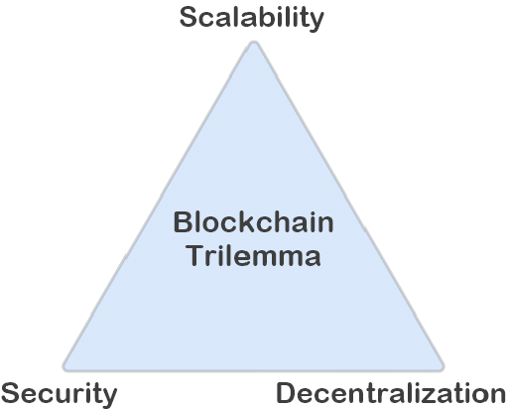

Slide 4
Blinkchain balances both dilemmas by increasing the requirement to join the network - similar to bitcoin’s hash-rate and kicks producer nodes which are unfit for the network’s required throughput by conducting a vote of confidence.
Blinkchain attains speed and decentralization in balance by
increasing requirements, encouraging nodes to join,
and kicks un-fit nodes

Slide 5
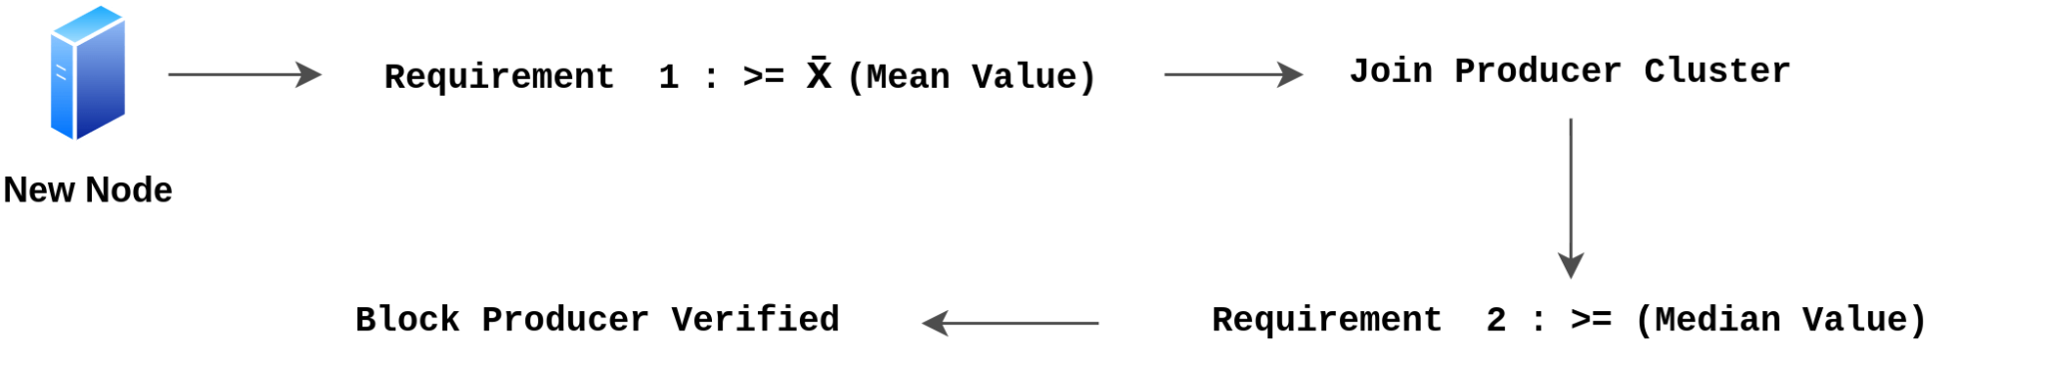
Requirement to Join
Requirement are categorized into two,
To join producer cluster - Mean Value
To produce blocks - Median Value

Slide 6
To Join - Production
On every n epoch, the Proof-of-Choice is conducted for the next n+1 epoch.
New producer nodes are only accepted at a certain interval of time when the slot opens for new nodes to join the producer-cluster.
Before accepting new nodes to join the network, there’ll be a purge event known as vote of confidence which will kick un-fit nodes
The nodes are required to submit a proof of requirement i.e., the primary requirement (mean value)

Slide 7
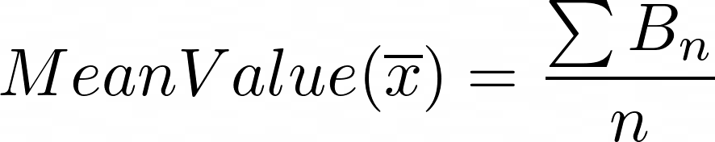

Primary Requirement
For a certain time interval in block-height, new nodes can provide their proofs to join the clusters

Slide 8
Benefits
Increase in requirement
Only better nodes can participate
Competition among nodes, with better participation each time
Mean Value = Average Value. Hence it increases on every node’s arrival

Slide 9
Next : 2.2 Vote of Confidence (Exit)

